Slide 1
Apache Kafka 0.8 basic training
Michael G. Noll, Verisign
mnoll@verisign.com / @miguno
July 2014

Slide 2
Update 2015-08-01:
Shameless plug! Since publishing this Kafka training deck about a year ago I joined Confluent Inc. as their Developer Evangelist.
Confluent is the US startup founded in 2014 by the creators of Apache Kafka who developed Kafka while at LinkedIn (see Forbes about Confluent). Next to building the world’s best stream data platform we are also providing professional Kafka trainings, which go even deeper as well as beyond my extensive training deck below.
http://www.confluent.io/training
I can say with confidence that these are the best and most effective Apache Kafka trainings available on the market. But you don’t have to take my word for it – feel free to take a look yourself and reach out to us if you’re interested.
—Michael

Slide 3
Kafka?
Part 1: Introducing Kafka
“Why should I stay awake for the full duration of this workshop?”
Part 2: Kafka core concepts
Topics, partitions, replicas, producers, consumers, brokers
Part 3: Operating Kafka
Architecture, hardware specs, deploying, monitoring, P&S tuning
Part 4: Developing Kafka apps
Writing to Kafka, reading from Kafka, testing, serialization, compression, example apps
Part 5: Playing with Kafka using Wirbelsturm
Wrapping up

Slide 4
Part 1: Introducing Kafka

Slide 5
Overview of Part 1: Introducing Kafka
Kafka?
Kafka adoption and use cases in the wild
At LinkedIn
At other companies
How fast is Kafka, and why?
Kafka + X for processing
Storm, Samza, Spark Streaming, custom apps

Slide 6
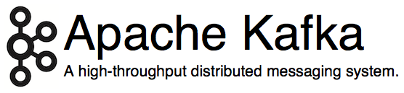
Kafka?
http://kafka.apache.org/
Originated at LinkedIn, open sourced in early 2011
Implemented in Scala, some Java
9 core committers, plus ~ 20 contributors
https://kafka.apache.org/committers.html
https://github.com/apache/kafka/graphs/contributors

Slide 7
Kafka?
LinkedIn’s motivation for Kafka was:
“A unified platform for handling all the real-time data feeds a large company might have.”
Must haves
High throughput to support high volume event feeds.
Support real-time processing of these feeds to create new, derived feeds.
Support large data backlogs to handle periodic ingestion from offline systems.
Support low-latency delivery to handle more traditional messaging use cases.
Guarantee fault-tolerance in the presence of machine failures.
http://kafka.apache.org/documentation.html#majordesignelements

Slide 8
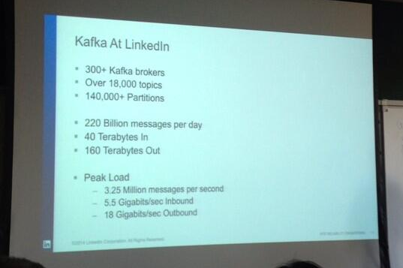
Kafka @ LinkedIn, 2014
(Numbers have increased since.)
https://twitter.com/SalesforceEng/status/466033231800713216/photo/1
http://www.hakkalabs.co/articles/site-reliability-engineering-linkedin-kafka-service

Slide 9
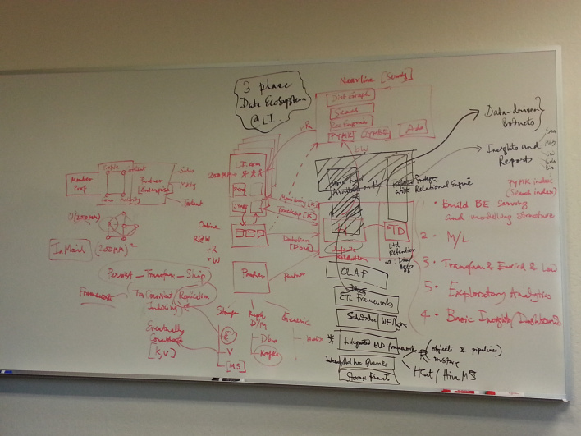
Data architecture @ LinkedIn, Feb 2013
(Numbers are aggregated across all their clusters.)
http://gigaom.com/2013/12/09/netflix-open-sources-its-data-traffic-cop-suro/

Slide 10
Kafka @ LinkedIn, 2014
Multiple data centers, multiple clusters
Mirroring between clusters / data centers
What type of data is being transported through Kafka?
Metrics: operational telemetry data
Tracking: everything a LinkedIn.com user does
Queuing: between LinkedIn apps, e.g. for sending emails
To transport data from LinkedIn’s apps to Hadoop, and back
In total ~ 200 billion events/day via Kafka
Tens of thousands of data producers, thousands of consumers
7 million events/sec (write), 35 million events/sec (read) <<< may include replicated events
But: LinkedIn is not even the largest Kafka user anymore as of 2014
http://www.hakkalabs.co/articles/site-reliability-engineering-linkedin-kafka-service
http://www.slideshare.net/JayKreps1/i-32858698
http://search-hadoop.com/m/4TaT4qAFQW1

Slide 11
Kafka @ LinkedIn, 2014
“For reference, here are the stats on one of LinkedIn's busiest clusters (at peak):
15 brokers
15,500 partitions (replication factor 2)
400,000 msg/s inbound
70 MB/s inbound
400 MB/s outbound”
https://kafka.apache.org/documentation.html#java

Slide 12
Staffing: Kafka team @ LinkedIn
Team of 8+ engineers
Site reliability engineers (Ops): at least 3
Developers: at least 5
SRE’s as well as DEV’s are on call 24x7
https://kafka.apache.org/committers.html
http://www.hakkalabs.co/articles/site-reliability-engineering-linkedin-kafka-service

Slide 13
Kafka adoption and use cases
LinkedIn: activity streams, operational metrics, data bus
400 nodes, 18k topics, 220B msg/day (peak 3.2M msg/s), May 2014
Netflix: real-time monitoring and event processing
Twitter: as part of their Storm real-time data pipelines
Spotify: log delivery (from 4h down to 10s), Hadoop
Loggly: log collection and processing
Mozilla: telemetry data
Airbnb, Cisco, Gnip, InfoChimps, Ooyala, Square, Uber, …
https://cwiki.apache.org/confluence/display/KAFKA/Powered+By

Slide 14
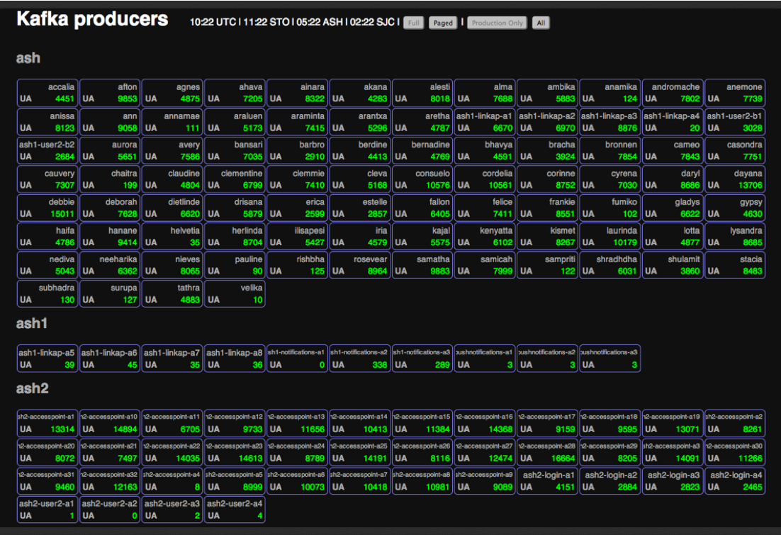
Kafka @ Spotify
https://www.jfokus.se/jfokus14/preso/Reliable-real-time-processing-with-Kafka-and-Storm.pdf (Feb 2014)

Slide 15
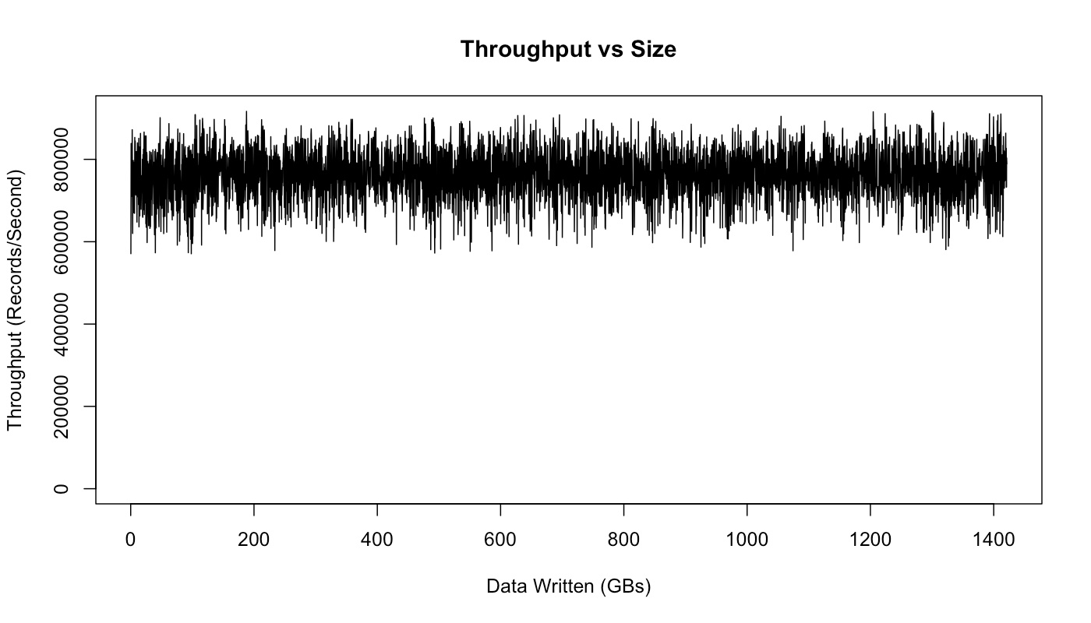
How fast is Kafka?
“Up to 2 million writes/sec on 3 cheap machines”
Using 3 producers on 3 different machines, 3x async replication
Only 1 producer/machine because NIC already saturated
Sustained throughput as stored data grows
Slightly different test config than 2M writes/sec above.
Test setup
Kafka trunk as of April 2013, but 0.8.1+ should be similar.
3 machines: 6-core Intel Xeon 2.5 GHz, 32GB RAM, 6x 7200rpm SATA, 1GigE
http://engineering.linkedin.com/kafka/benchmarking-apache-kafka-2-million-writes-second-three-cheap-machines

Slide 16
Why is Kafka so fast?
Fast writes:
While Kafka persists all data to disk, essentially all writes go to the page cache of OS, i.e. RAM.
Cf. hardware specs and OS tuning (we cover this later)
Fast reads:
Very efficient to transfer data from page cache to a network socket
Linux: sendfile() system call
Combination of the two = fast Kafka!
Example (Operations): On a Kafka cluster where the consumers are mostly caught up you will see no read activity on the disks as they will be serving data entirely from cache.
http://kafka.apache.org/documentation.html#persistence

Slide 17
Why is Kafka so fast?
Example: Loggly.com, who run Kafka & Co. on Amazon AWS
“99.99999% of the time our data is coming from disk cache and RAM; only very rarely do we hit the disk.”
“One of our consumer groups (8 threads) which maps a log to a customer can process about 200,000 events per second draining from 192 partitions spread across 3 brokers.”
Brokers run on m2.xlarge Amazon EC2 instances backed by provisioned IOPS
http://www.developer-tech.com/news/2014/jun/10/why-loggly-loves-apache-kafka-how-unbreakable-infinitely-scalable-messaging-makes-log-management-better/

Slide 18
Kafka + X for processing the data?
Kafka + Storm often used in combination, e.g. Twitter
Kafka + custom
“Normal” Java multi-threaded setups
Akka actors with Scala or Java, e.g. Ooyala
Recent additions:
Samza (since Aug ’13) – also by LinkedIn
Spark Streaming, part of Spark (since Feb ’13)
Kafka + Camus for Kafka->Hadoop ingestion
https://cwiki.apache.org/confluence/display/KAFKA/Powered+By

Slide 19
Part 2: Kafka core concepts

Slide 20
Overview of Part 2: Kafka core concepts
A first look
Topics, partitions, replicas, offsets
Producers, brokers, consumers
Putting it all together

Slide 21
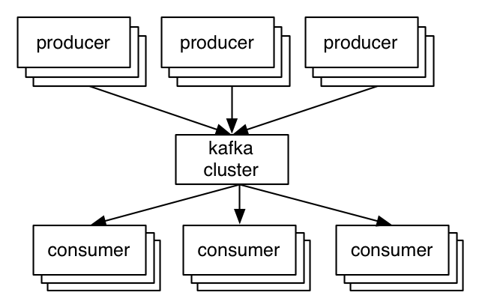
A first look
The who is who
Producers write data to brokers.
Consumers read data from brokers.
All this is distributed.
The data
Data is stored in topics.
Topics are split into partitions, which are replicated.

Slide 22
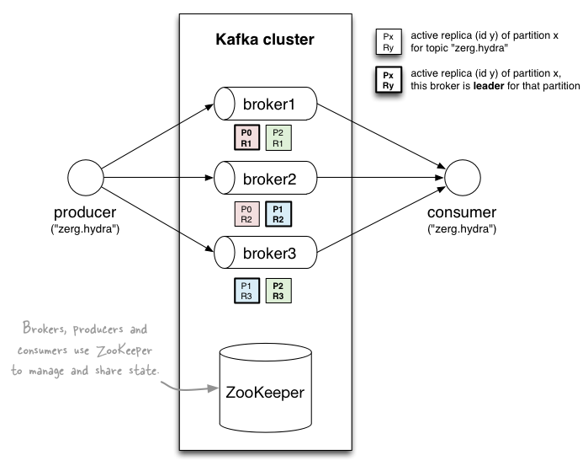
A first look
http://www.michael-noll.com/blog/2013/03/13/running-a-multi-broker-apache-kafka-cluster-on-a-single-node/

Slide 23
Topics
Topic: feed name to which messages are published
Example: “zerg.hydra”
Kafka prunes “head” based on age or max size or “key”
Producer A1
Kafka topic
Producer A2
…
…
new
Producer An
Older msgs
Newer msgs
Producers always append to “tail”
(think: append to a file)
Broker(s)

Slide 24
Topics
Consumer group C1
Consumers use an “offset pointer” to
track/control their read progress
(and decide the pace of consumption)
Consumer group C2
Producer A1
Producer A2
…
…
new
Producer An
Older msgs
Newer msgs
Producers always append to “tail”
(think: append to a file)
Broker(s)

Slide 25
Topics
Creating a topic
CLI
API https://github.com/miguno/kafka-storm-starter/blob/develop/src/main/scala/com/miguno/kafkastorm/storm/KafkaStormDemo.scala
Auto-create via auto.create.topics.enable = true
Modifying a topic
https://kafka.apache.org/documentation.html#basic_ops_modify_topic
Deleting a topic: DON’T in 0.8.1.x!
$ kafka-topics.sh --zookeeper zookeeper1:2181 --create --topic zerg.hydra \ --partitions 3 --replication-factor 2 \ --config x=y

Slide 26
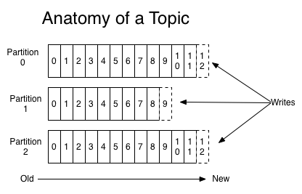
Partitions
A topic consists of partitions.
Partition: ordered + immutable sequence of messages that is continually appended to

Slide 27
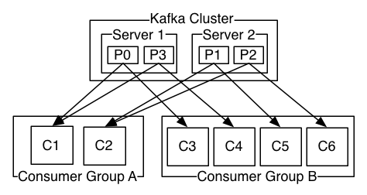
Partitions
#partitions of a topic is configurable
#partitions determines max consumer (group) parallelism
Cf. parallelism of Storm’s KafkaSpout via builder.setSpout(,,N)
Consumer group A, with 2 consumers, reads from a 4-partition topic
Consumer group B, with 4 consumers, reads from the same topic

Slide 28
Partition offsets
Offset: messages in the partitions are each assigned a unique (per partition) and sequential id called the offset
Consumers track their pointers via (offset, partition, topic) tuples
Consumer group C1

Slide 29
Replicas of a partition
Replicas: “backups” of a partition
They exist solely to prevent data loss.
Replicas are never read from, never written to.
They do NOT help to increase producer or consumer parallelism!
Kafka tolerates (numReplicas - 1) dead brokers before losing data
LinkedIn: numReplicas == 2 → 1 broker can die

Slide 30
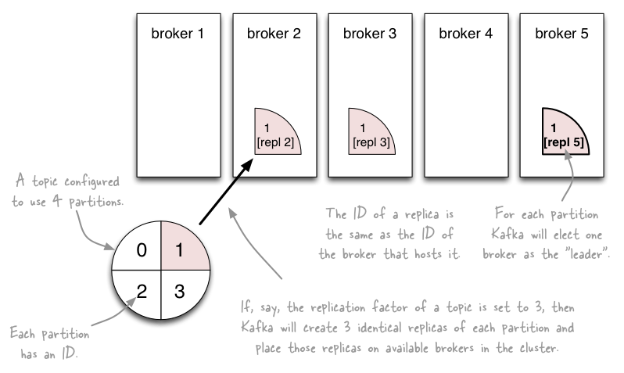
Topics vs. Partitions vs. Replicas
http://www.michael-noll.com/blog/2013/03/13/running-a-multi-broker-apache-kafka-cluster-on-a-single-node/

Slide 31
Inspecting the current state of a topic
--describe the topic
Leader: brokerID of the currently elected leader broker
Replica ID’s = broker ID’s
ISR = “in-sync replica”, replicas that are in sync with the leader
In this example:
Broker 0 is leader for partition 1.
Broker 1 is leader for partitions 0 and 2.
All replicas are in-sync with their respective leader partitions.
$ kafka-topics.sh --zookeeper zookeeper1:2181 --describe --topic zerg.hydra Topic:zerg2.hydra PartitionCount:3 ReplicationFactor:2 Configs:
Topic: zerg2.hydra Partition: 0 Leader: 1 Replicas: 1,0 Isr: 1,0
Topic: zerg2.hydra Partition: 1 Leader: 0 Replicas: 0,1 Isr: 0,1
Topic: zerg2.hydra Partition: 2 Leader: 1 Replicas: 1,0 Isr: 1,0

Slide 32
Let’s recap
The who is who
Producers write data to brokers.
Consumers read data from brokers.
All this is distributed.
The data
Data is stored in topics.
Topics are split into partitions which are replicated.

Slide 33
Putting it all together
http://www.michael-noll.com/blog/2013/03/13/running-a-multi-broker-apache-kafka-cluster-on-a-single-node/

Slide 34
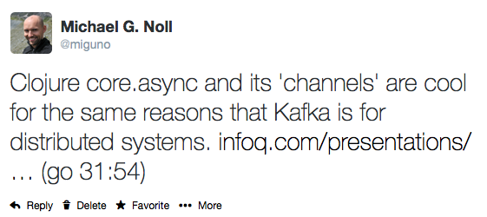
Side note (opinion)
Drawing a conceptual line from Kafka to Clojure's core.async
Cf. talk "Clojure core.async Channels", by Rich Hickey, at ~ 31m54 http://www.infoq.com/presentations/clojure-core-async

Slide 35
Part 3: Operating Kafka

Slide 36
Overview of Part 3: Operating Kafka
Kafka architecture
Kafka hardware specs
Deploying Kafka
Monitoring Kafka
Kafka apps
Kafka itself
ZooKeeper
"Auditing" Kafka (not: security audit)
P&S tuning
Ops-related Kafka references

Slide 37
Kafka architecture
Kafka brokers
You can run clusters with 1+ brokers.
Each broker in a cluster must have a unique broker.id.

Slide 38
Kafka architecture
Kafka requires ZooKeeper
LinkedIn runs (old) ZK 3.3.4, but latest 3.4.5 works, too.
ZooKeeper
v0.8: used by brokers and consumers, but not by producers.
Brokers: general state information, leader election, etc.
Consumers: primarily for tracking message offsets (cf. later)
v0.9: used by brokers only
Consumers will use special Kafka topics instead of ZooKeeper
Will substantially reduce the load on ZooKeeper for large deployments

Slide 39
Kafka broker hardware specs @ LinkedIn
Solely dedicated to running Kafka, run nothing else.
1 Kafka broker instance per machine
2x 4-core Intel Xeon (info outdated?)
64 GB RAM (up from 24 GB)
Only 4 GB used for Kafka broker, remaining 60 GB for page cache
Page cache is what makes Kafka fast
RAID10 with 14 spindles
More spindles = higher disk throughput
Cache on RAID, with battery backup
Before H/W upgrade: 8x SATA drives (7200rpm), not sure about RAID
1 GigE (?) NICs
EC2 example: m2.2xlarge @ $0.34/hour, with provisioned IOPS

Slide 40
ZooKeeper hardware specs @ LinkedIn
ZooKeeper servers
Solely dedicated to running ZooKeeper, run nothing else.
1 ZooKeeper instance per machine
SSD’s dramatically improve performance
In v0.8.x, brokers and consumers must talk to ZK. In large-scale environments (many consumers, many topics and partitions) this means ZK can become a bottleneck because it processes requests serially. And this processing depends primarily on I/O performance.
1 GigE (?) NICs
ZooKeeper in LinkedIn’s architecture
5-node ZK ensembles = tolerates 2 dead nodes
1 ZK ensemble for all Kafka clusters within a data center
LinkedIn runs multiple data centers, with multiple Kafka clusters

Slide 41
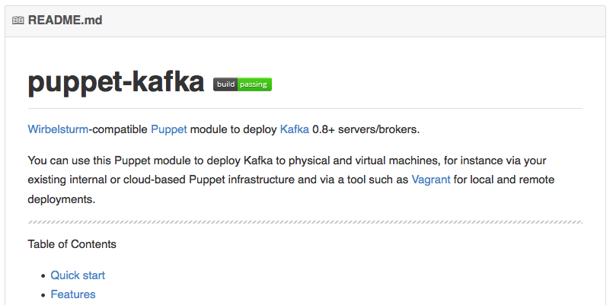
Deploying Kafka
Puppet module
https://github.com/miguno/puppet-kafka
Hiera-compatible, rspec tests, Travis CI setup (e.g. to test against multiple versions of Puppet and Ruby, Puppet style checker/lint, etc.)
RPM packaging script for RHEL 6
https://github.com/miguno/wirbelsturm-rpm-kafka
Digitally signed by yum@michael-noll.com
RPM is built on a Wirbelsturm-managed build server
Public (Wirbelsturm) S3-backed yum repo
https://s3.amazonaws.com/yum.miguno.com/bigdata/

Slide 42
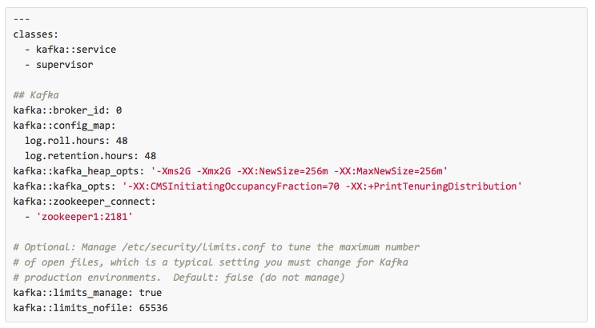
Deploying Kafka
Hiera example

Slide 43
Operating Kafka
Typical operations tasks include:
Adding or removing brokers
Example: ensure a newly added broker actually receives data, which requires moving partitions from existing brokers to the new broker
Kafka provides helper scripts (cf. below) but still manual work involved
Balancing data/partitions to ensure best performance
Add new topics, re-configure topics
Example: Increasing #partitions of a topic to increase max parallelism
Apps management: new producers, new consumers
See Ops-related references at the end of this part

Slide 44
Lessons learned from operating Kafka at LinkedIn
Biggest challenge has been to manage hyper growth
Growth of Kafka adoption: more producers, more consumers, …
Growth of data: more LinkedIn.com users, more user activity, …
Typical tasks at LinkedIn
Educating and coaching Kafka users.
Expanding Kafka clusters, shrinking clusters.
Monitoring consumer apps – “Hey, my stuff stopped. Kafka’s fault!”
http://www.hakkalabs.co/articles/site-reliability-engineering-linkedin-kafka-service

Slide 45
Kafka security
Original design was not created with security in mind.
Discussion started in June 2014 to add security features.
Covers transport layer security, data encryption at rest, non-repudiation, A&A, …
See [DISCUSS] Kafka Security Specific Features
At the moment there's basically no security built-in.

Slide 46
Monitoring Kafka

Slide 47
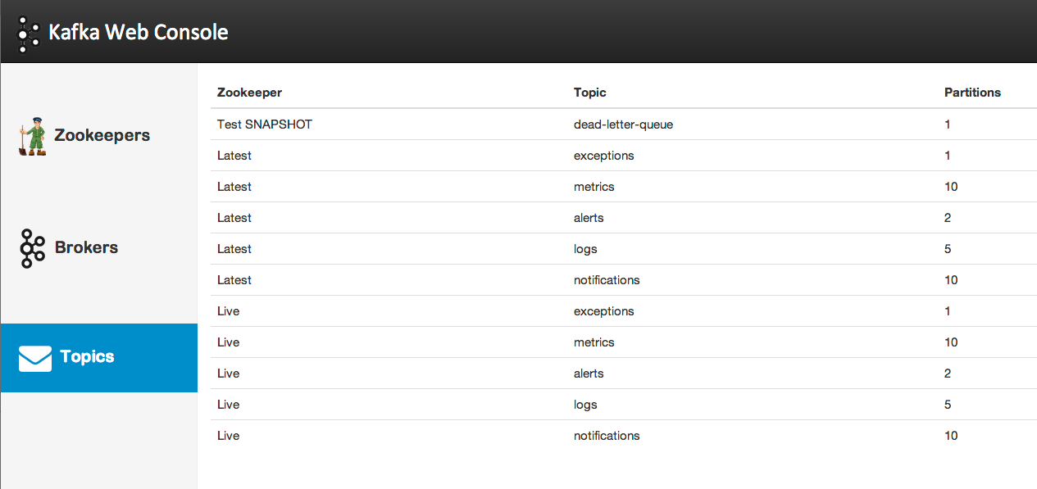
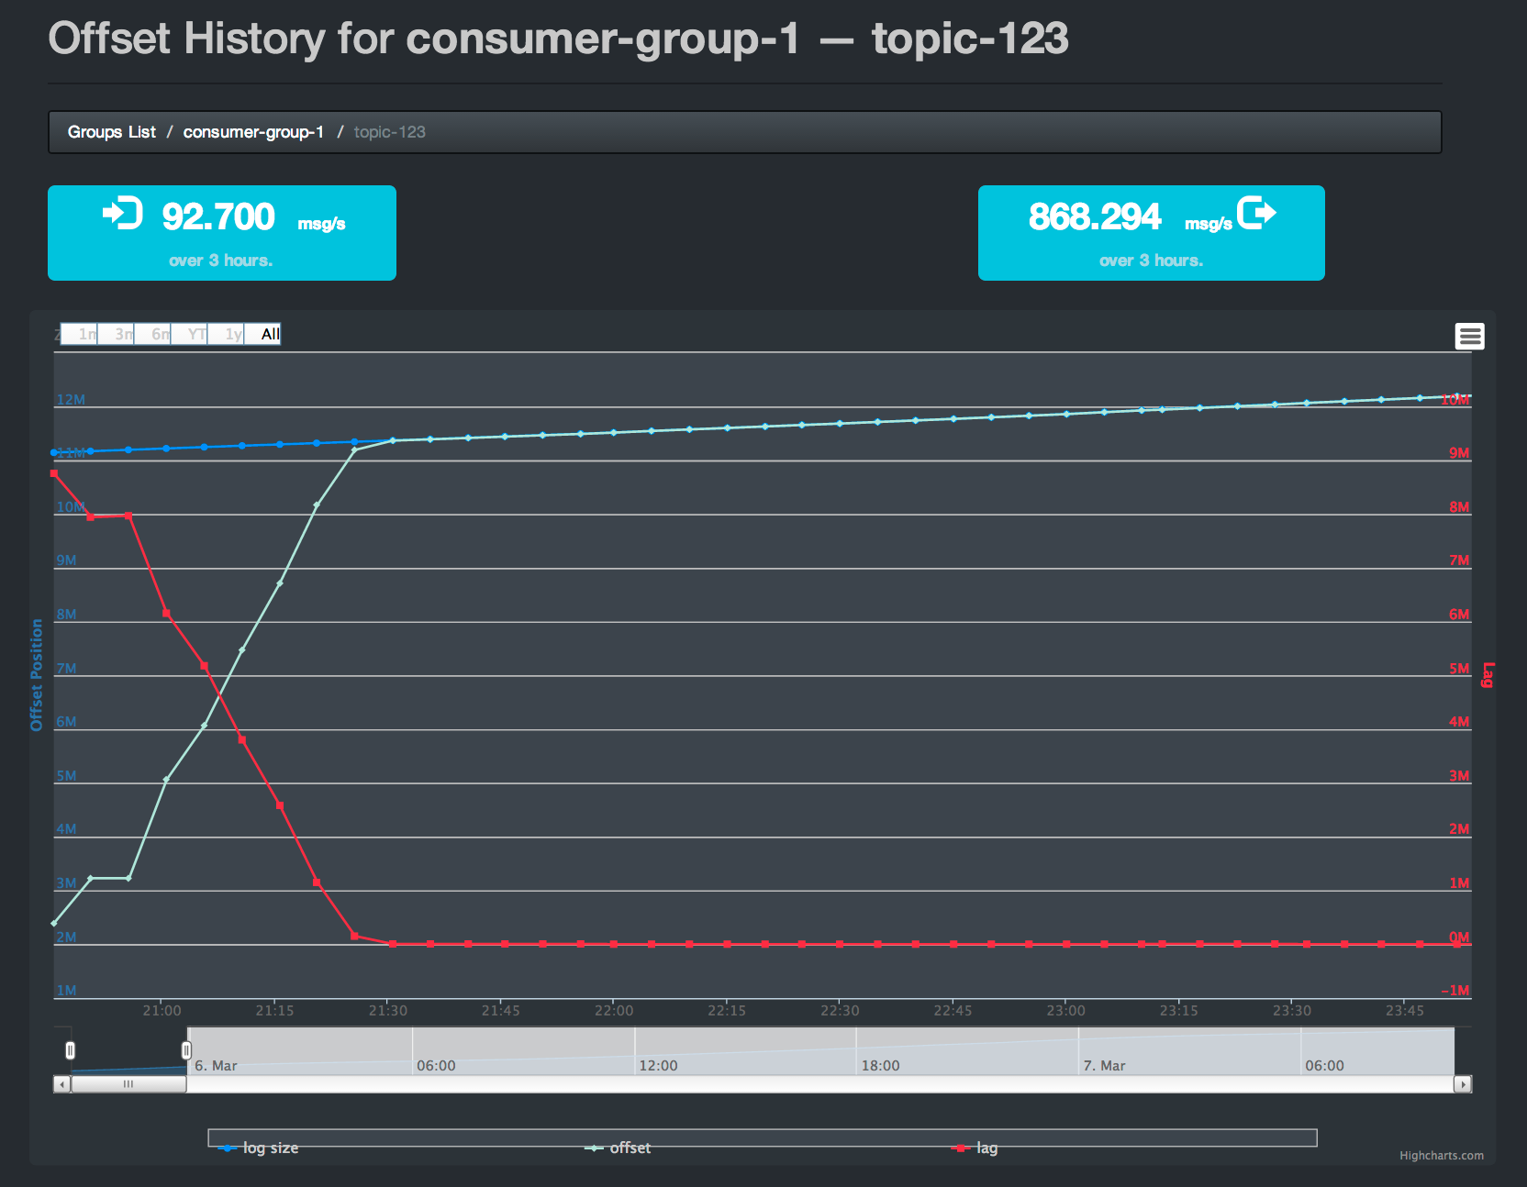
Monitoring Kafka
Nothing fancy built into Kafka (e.g. no UI) but see:
https://cwiki.apache.org/confluence/display/KAFKA/System+Tools
https://cwiki.apache.org/confluence/display/KAFKA/Ecosystem
Kafka Web Console
Kafka Offset Monitor

Slide 48
Monitoring Kafka
Use of standard monitoring tools recommended
Graphite
Puppet module: https://github.com/miguno/puppet-graphite
Java API, also used by Kafka: http://metrics.codahale.com/
JMX
https://kafka.apache.org/documentation.html#monitoring
Collect logging files into a central place
Logstash/Kibana and friends
Helps with troubleshooting, debugging, etc. – notably if you can correlate logging data with numeric metrics

Slide 49
Monitoring Kafka apps
Almost all problems are due to:
Consumer lag
Rebalancing <<< we cover this later in part 4

Slide 50
Monitoring Kafka apps: consumer lag
Lag = how far your consumer is behind the producers
Consumer group C1
Producer A1
Producer A2
…
…
new
Producer An
Older msgs
Newer msgs
Broker(s)
Lag is a consumer problem
Too slow, too much GC, losing connection to ZK or Kafka, …
Bug or design flaw in consumer
Operational mistakes: e.g. you brought up 6 servers in parallel, each one in turn triggering rebalancing, then hit Kafka's rebalance limit; cf. rebalance.max.retries (default: 4) & friends

Slide 51
Monitoring Kafka itself (1 of 3)
Under-replicated partitions
For example, because a broker is down.
Means cluster runs in degraded state.
FYI: LinkedIn runs with replication factor of 2 => 1 broker can die.
Offline partitions
Even worse than under-replicated partitions!
Serious problem (data loss) if anything but 0 offline partitions.

Slide 52
Monitoring Kafka itself (1 of 3)
Data size on disk
Should be balanced across disks/brokers
Data balance even more important than partition balance
FYI: New script in v0.8.1 to balance data/partitions across brokers
Broker partition balance
Count of partitions should be balanced evenly across brokers
See new script above.

Slide 53
Monitoring Kafka itself (1 of 3)
Leader partition count
Should be balanced across brokers so that each broker gets the same amount of load
Only 1 broker is ever the leader of a given partition, and only this broker is going to talk to producers + consumers for that partition
Non-leader replicas are used solely as safeguards against data loss
Feature in v0.8.1 to auto-rebalance the leaders and partitions in case a broker dies, but it does not work that well yet (SRE's still have to do this manually at this point).
Network utilization
Maxed network one reason for under-replicated partitions
LinkedIn don't run anything but Kafka on the brokers, so network max is due to Kafka. Hence, when they max the network, they need to add more capacity across the board.

Slide 54
Monitoring ZooKeeper
Ensemble (= cluster) availability
LinkedIn run 5-node ensembles = tolerates 2 dead
Twitter run 13-node ensembles = tolerates 6 dead
Latency of requests
Metric target is 0 ms when using SSD’s in ZooKeeper machines.
Why? Because SSD’s are so fast they typically bring down latency below ZK’s metric granularity (which is per-ms).
Outstanding requests
Metric target is 0.
Why? Because ZK processes all incoming requests serially. Non-zero values mean that requests are backing up.

Slide 55
"Auditing" Kafka
LinkedIn's way to detect data loss etc.

Slide 56
“Auditing” Kafka
LinkedIn's way to detect data loss etc. in Kafka
Not part of open source stack yet. May come in the future.
In short: custom producer+consumer app that is hooked into monitoring.
Value proposition
Monitor whether you're losing messages/data.
Monitor whether your pipelines can handle the incoming data load.
http://www.hakkalabs.co/articles/site-reliability-engineering-linkedin-kafka-service

Slide 57
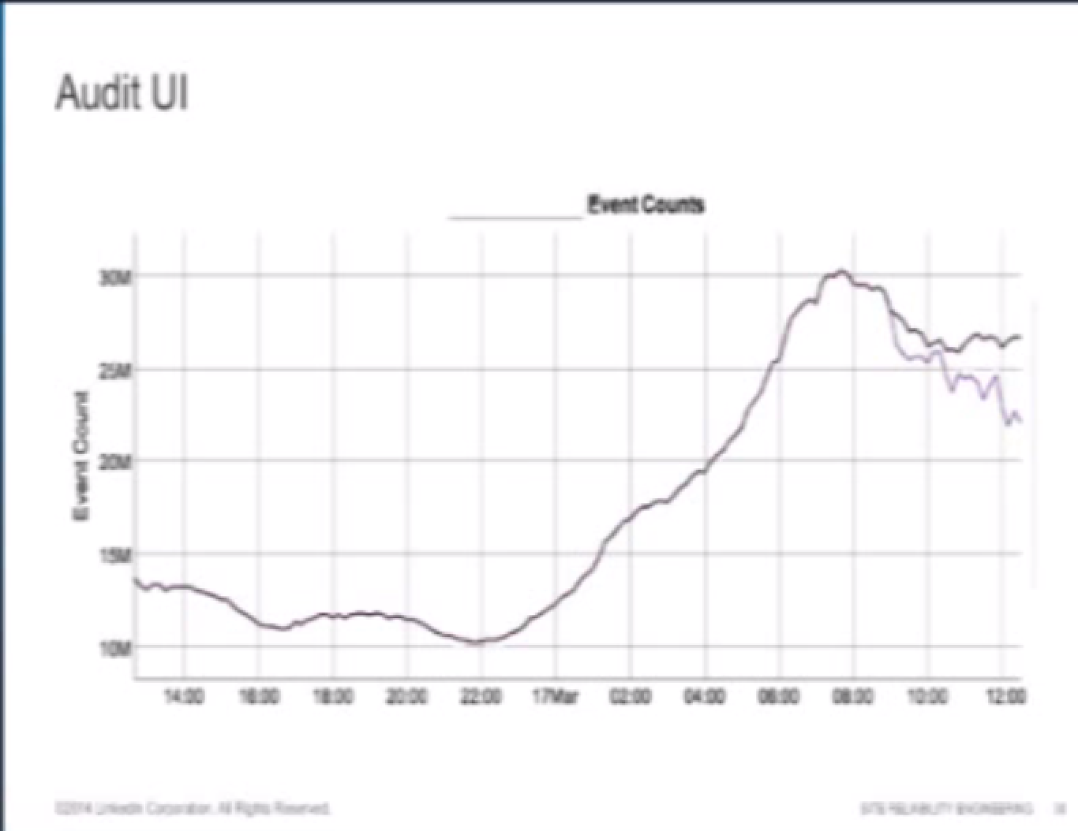
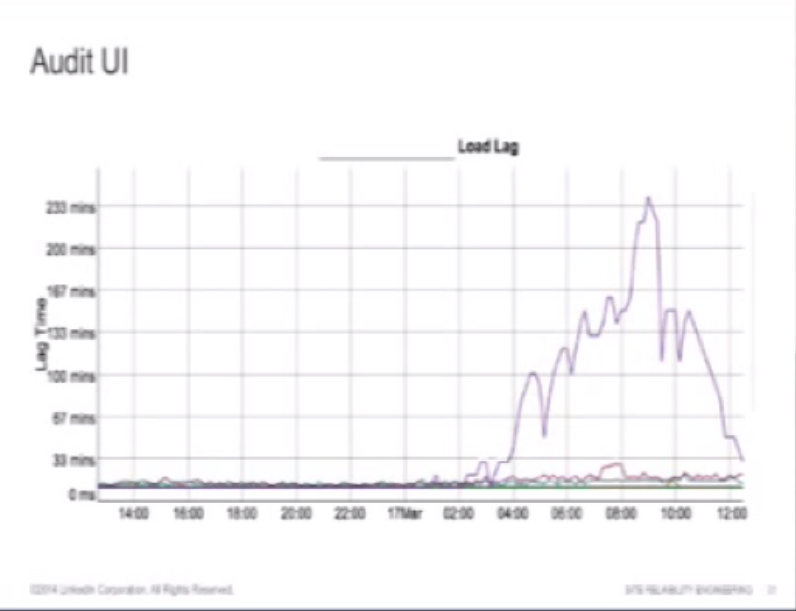
LinkedIn's Audit UI: a first look
Example 1: Count discrepancy
Caused by messages failing to reach a downstream Kafka cluster
Example 2: Load lag

Slide 58
“Auditing” Kafka
Every producer is also writing messages into a special topic about how many messages it produced, every 10mins.
Example: "Over the last 10mins, I sent N messages to topic X.”
This metadata gets mirrored like any other Kafka data.
Audit consumer
1 audit consumer per Kafka cluster
Reads every single message out of “its” Kafka cluster. It then calculates counts for each topic, and writes those counts back into the same special topic, every 10mins.
Example: "I saw M messages in the last 10mins for topic X in THIS cluster”
And the next audit consumer in the next, downstream cluster does the same thing.

Slide 59
“Auditing” Kafka
Monitoring audit consumers
Completeness check
"#msgs according to producer == #msgs seen by audit consumer?"
Lag
"Can the audit consumers keep up with the incoming data rate?"
If audit consumers fall behind, then all your tracking data falls behind as well, and you don't know how many messages got produced.

Slide 60
“Auditing” Kafka
Audit UI
Only reads data from that special "metrics/monitoring" topic, but this data is reads from every Kafka cluster at LinkedIn.
What they producers said they wrote in.
What the audit consumers said they saw.
Shows correlation graphs (producers vs. audit consumers)
For each tier, it shows how many messages there were in each topic over any given period of time.
Percentage of how much data got through (from cluster to cluster).
If the percentage drops below 100%, then emails are sent to Kafka SRE+DEV as well as their Hadoop ETL team because that stops the Hadoop pipelines from functioning properly.

Slide 61
LinkedIn's Audit UI: a closing look
Example 1: Count discrepancy
Caused by messages failing to reach a downstream Kafka cluster
Example 2: Load lag

Slide 62
Kafka performance tuning

Slide 63
OS tuning
Kernel tuning
Don’t swap! vm.swappiness = 0 (RHEL 6.5 onwards: 1)
Allow more dirty pages but less dirty cache.
LinkedIn have lots of RAM in servers, most of it is for page cache (60 of 64 GB). They let dirty pages built up, but cache should be available as Kafka does lots of disk and network I/O.
See vm.dirty_*_ratio & friends
Disk throughput
Longer commit interval on mount points. (ext3 or ext4?)
Normal interval for ext3 mount point is 30s (?) between flushes; LinkedIn: 120s. They can tolerate losing 2mins worth of data (because of partition replicas) so they rather prefer higher throughput here.
More spindles (RAID10 w/ 14 disks)

Slide 64
Java/JVM tuning
Biggest issue: garbage collection
And, most of the time, the only issue
Goal is to minimize GC pause times
Aka “stop-the-world” events – apps are halted until GC finishes

Slide 65
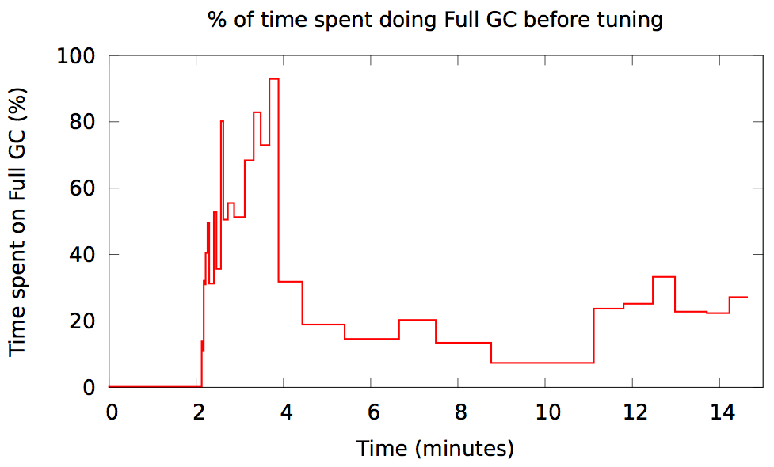
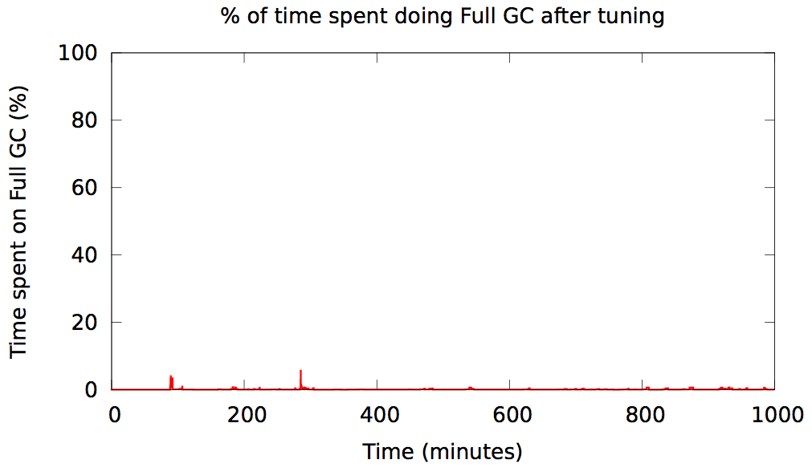
Java garbage collection in Kafka @ Spotify
Before tuning
After tuning
https://www.jfokus.se/jfokus14/preso/Reliable-real-time-processing-with-Kafka-and-Storm.pdf

Slide 66
Java/JVM tuning
Good news: use JDK7u51 or later and have a quiet life!
LinkedIn: Oracle JDK, not OpenJDK
Silver bullet is new G1 “garbage-first” garbage collector
Available since JDK7u4.
Substantial improvement over all previous GC’s, at least for Kafka.
$ java -Xms4g -Xmx4g -XX:PermSize=48m -XX:MaxPermSize=48m
-XX:+UseG1GC
-XX:MaxGCPauseMillis=20
-XX:InitiatingHeapOccupancyPercent=35

Slide 67
Kafka configuration tuning
Often not much to do beyond using the defaults, yay. ☺
Key candidates for tuning:
num.io.threads | should be >= #disks (start testing with == #disks)
num.network.threads | adjust it based on (concurrent) #producers, #consumers, and replication factor

Slide 68
Kafka usage tuning – lessons learned from others
Don't break things up into separate topics unless the data in them is truly independent.
Consumer behavior can (and will) be extremely variable, don’t assume you will always be consuming as fast as you are producing.
Keep time related messages in the same partition.
Consumer behavior can extremely variable, don't assume the lag on all your partitions will be similar.
Design a partitioning scheme, so that the owner of one partition can stop consuming for a long period of time and your application will be minimally impacted (for example, partition by transaction id)
http://grokbase.com/t/kafka/users/145qtx4z1c/topic-partitioning-strategy-for-large-data

Slide 69
Ops-related references
Kafka FAQ
https://cwiki.apache.org/confluence/display/KAFKA/FAQ
Kafka operations
https://kafka.apache.org/documentation.html#operations
Kafka system tools
https://cwiki.apache.org/confluence/display/KAFKA/System+Tools
Consumer offset checker, get offsets for a topic, print metrics via JMX to console, read from topic A and write to topic B, verify consumer rebalance
Kafka replication tools
https://cwiki.apache.org/confluence/display/KAFKA/Replication+tools
Caveat: Some sections of this document are slightly outdated.
Controlled shutdown, preferred leader election tool, reassign partitions tool
Kafka tutorial
http://www.michael-noll.com/blog/2013/03/13/running-a-multi-broker-apache-kafka-cluster-on-a-single-node/

Slide 70
Part 4: Developing Kafka apps

Slide 71
Overview of Part 4: Developing Kafka apps
Writing data to Kafka with producers
Example producer
Producer types (async, sync)
Message acking and batching of messages
Write operations behind the scenes – caveats ahead!
Reading data from Kafka with consumers
High-level consumer API and simple consumer API
Consumer groups
Rebalancing
Testing Kafka
Serialization in Kafka
Data compression in Kafka
Example Kafka applications
Dev-related Kafka references

Slide 72
Writing data to Kafka

Slide 73
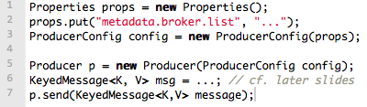
Writing data to Kafka
You use Kafka “producers” to write data to Kafka brokers.
Available for JVM (Java, Scala), C/C++, Python, Ruby, etc.
The Kafka project only provides the JVM implementation.
Has risk that a new Kafka release will break non-JVM clients.
A simple example producer:
Full details at:
https://cwiki.apache.org/confluence/display/KAFKA/0.8.0+Producer+Example

Slide 74
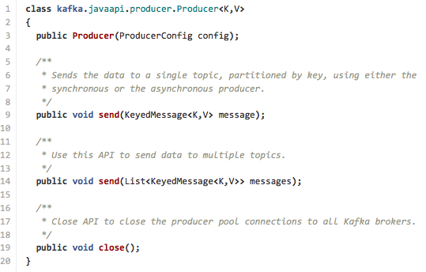
Producers
The Java producer API is very simple.
We’ll talk about the slightly confusing details next. ☺

Slide 75
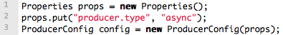
Producers
Two types of producers: “async” and “sync”
Same API and configuration, but slightly different semantics.
What applies to a sync producer almost always applies to async, too.
Async producer is preferred when you want higher throughput.
Important configuration settings for either producer type:
client.id | identifies producer app, e.g. in system logs
producer.type | async or sync
request.required.acks | acking semantics, cf. next slides
serializer.class | configure encoder, cf. slides on Avro usage
metadata.broker.list | cf. slides on bootstrapping list of brokers

Slide 76
Sync producers
Straight-forward so I won’t cover sync producers here
Please go to https://kafka.apache.org/documentation.html
Most important thing to remember: producer.send() will block!

Slide 77
Async producer
Sends messages in background = no blocking in client.
Provides more powerful batching of messages (see later).
Wraps a sync producer, or rather a pool of them.
Communication from async->sync producer happens via a queue.
Which explains why you may see kafka.producer.async.QueueFullException
Each sync producer gets a copy of the original async producer config, including the request.required.acks setting (see later).
Implementation details: Producer, async.AsyncProducer, async.ProducerSendThread, ProducerPool, async.DefaultEventHandler#send()

Slide 78
Async producer
Caveats
Async producer may drop messages if its queue is full.
Solution 1: Don’t push data to producer faster than it is able to send to brokers.
Solution 2: Queue full == need more brokers, add them now! Use this solution in favor of solution 3 particularly if your producer cannot block (async producers).
Solution 3: Set queue.enqueue.timeout.ms to -1 (default). Now the producer will block indefinitely and will never willingly drop a message.
Solution 4: Increase queue.buffering.max.messages (default: 10,000).
In 0.8 an async producer does not have a callback for send() to register error handlers. Callbacks will be available in 0.9.

Slide 79
Producers
Two aspects worth mentioning because they significantly influence Kafka performance:
Message acking
Batching of messages

Slide 80
1) Message acking
Background:
In Kafka, a message is considered committed when “any required” ISR (in-sync replicas) for that partition have applied it to their data log.
Message acking is about conveying this “Yes, committed!” information back from the brokers to the producer client.
Exact meaning of “any required” is defined by request.required.acks.
Only producers must configure acking
Exact behavior is configured via request.required.acks, which determines when a produce request is considered completed.
Allows you to trade latency (speed) <-> durability (data safety).
Consumers: Acking and how you configured it on the side of producers do not matter to consumers because only committed messages are ever given out to consumers. They don’t need to worry about potentially seeing a message that could be lost if the leader fails.

Slide 81
1) Message acking
Typical values of request.required.acks
0: producer never waits for an ack from the broker.
Gives the lowest latency but the weakest durability guarantees.
1: producer gets an ack after the leader replica has received the data.
Gives better durability as the we wait until the lead broker acks the request. Only msgs that were written to the now-dead leader but not yet replicated will be lost.
-1: producer gets an ack after all ISR have received the data.
Gives the best durability as Kafka guarantees that no data will be lost as long as at least one ISR remains.
Beware of interplay with request.timeout.ms!
"The amount of time the broker will wait trying to meet the `request.required.acks` requirement before sending back an error to the client.”
Caveat: Message may be committed even when broker sends timeout error to client (e.g. because not all ISR ack’ed in time). One reason for this is that the producer acknowledgement is independent of the leader-follower replication, and ISR’s send their acks to the leader, the latter of which will reply to the client.
better
latency
better
durability

Slide 82
2) Batching of messages
Batching improves throughput
Tradeoff is data loss if client dies before pending messages have been sent.
You have two options to “batch” messages in 0.8:
Use send(listOfMessages).
Sync producer: will send this list (“batch”) of messages right now. Blocks!
Async producer: will send this list of messages in background “as usual”, i.e. according to batch-related configuration settings. Does not block!
Use send(singleMessage) with async producer.
For async the behavior is the same as send(listOfMessages).

Slide 83
2) Batching of messages
Option 1: How send(listOfMessages) works behind the scenes
The original list of messages is partitioned (randomly if the default partitioner is used) based on their destination partitions/topics, i.e. split into smaller batches.
Each post-split batch is sent to the respective leader broker/ISR (the individual send()’s happen sequentially), and each is acked by its respective leader broker according to request.required.acks.
p4
p4
partitioner.class
p6
p1
p4
p4
p6
p6
p6
p1
p4
p4
send()
Current leader ISR (broker) for partition 4
p6
p6
send()
Current leader ISR (broker) for partition 6
p1
…and so on…

Slide 84
2) Batching of messages
Option 2: Async producer
Standard behavior is to batch messages
Semantics are controlled via producer configuration settings
batch.num.messages
queue.buffering.max.ms + queue.buffering.max.messages
queue.enqueue.timeout.ms
And more, see producer configuration docs.
Remember: Async producer simply wraps sync producer!
But the batch-related config settings above have no effect on “true” sync producers, i.e. when used without a wrapping async producer.

Slide 85
FYI: upcoming producer configuration changes
Kafka 0.8 | Kafka 0.9 (unreleased)
metadata.broker.list | bootstrap.servers
request.required.acks | acks
batch.num.messages | batch.size
message.send.max.retries | retries
(This list is not complete, see Kafka docs for details.)

Slide 86
Write operations behind the scenes
When writing to a topic in Kafka, producers write directly to the partition leaders (brokers) of that topic
Remember: Writes always go to the leader ISR of a partition!
This raises two questions:
How to know the “right” partition for a given topic?
How to know the current leader broker/replica of a partition?

Slide 87
1) How to know the “right” partition when sending?
In Kafka, a producer – i.e. the client – decides to which target partition a message will be sent.
Can be random ~ load balancing across receiving brokers.
Can be semantic based on message “key”, e.g. by user ID or domain name.
Here, Kafka guarantees that all data for the same key will go to the same partition, so consumers can make locality assumptions.
But there’s one catch with line 2 (i.e. no key) in Kafka 0.8.

Slide 88
Keyed vs. non-keyed messages in Kafka 0.8
If a key is not specified:
Producer will ignore any configured partitioner.
It will pick a random partition from the list of available partitions and stick to it for some time before switching to another one = NOT round robin or similar!
Why? To reduce number of open sockets in large Kafka deployments (KAFKA-1017).
Default: 10mins, cf. topic.metadata.refresh.interval.ms
See implementation in DefaultEventHandler#getPartition()
If there are fewer producers than partitions at a given point of time, some partitions may not receive any data. How to fix if needed?
Try to reduce the metadata refresh interval topic.metadata.refresh.interval.ms
Specify a message key and a customized random partitioner.
In practice it is not trivial to implement a correct “random” partitioner in Kafka 0.8.
Partitioner interface in Kafka 0.8 lacks sufficient information to let a partitioner select a random and available partition. Same issue with DefaultPartitioner.
Notes:
Apparently implementing a custom random partitioner correctly is tricky as of 0.8.0 because the Partitioner interface lacks sufficient information to let a partitioner select a random and AVAILABLE partition (see discussion at http://bit.ly/1fekbAd). That being said Kafka's DefaultPartitioner seems to suffer from the same problem, i.e. the information it has available to make partitioning decisions lacks information about AVAILABLE partitions.

Slide 89
Keyed vs. non-keyed messages in Kafka 0.8
If a key is specified:
Key is retained as part of the msg, will be stored in the broker.
One can design a partition function to route the msg based on key.
The default partitioner assigns messages to a partition based on their key hashes, via key.hashCode % numPartitions.
Caveat:
If you specify a key for a message but do not explicitly wire in a custom partitioner via partitioner.class, your producer will use the default partitioner.
So without a custom partitioner, messages with the same key will still end up in the same partition! (cf. default partitioner’s behavior above)

Slide 90
2) How to know the current leader of a partition?
Producers: broker discovery aka bootstrapping
Producers don’t talk to ZooKeeper, so it’s not through ZK.
Broker discovery is achieved by providing producers with a “bootstrapping” broker list, cf. metadata.broker.list
These brokers inform the producer about all alive brokers and where to find current partition leaders. The bootstrap brokers do use ZK for that.
Impacts on failure handling
In Kafka 0.8 the bootstrap list is static/immutable during producer run-time. This has limitations and problems as shown in next slide.
The current bootstrap approach will improve in Kafka 0.9. This change will make the life of Ops easier.

Slide 91
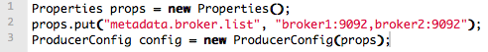
Bootstrapping in Kafka 0.8
Scenario: N=5 brokers total, 2 of which are for bootstrap
Do’s:
Take down one bootstrap broker (e.g. broker2), repair it, and bring it back.
In terms of impacts on broker discovery, you can do whatever you want to brokers 3-5.
Don’ts:
Stop all bootstrap brokers 1+2. If you do, the producer stops working!
To improve operational flexibility, use VIP’s or similar for values in metadata.broker.list.
broker1
broker2
broker3
broker4
broker5

Slide 92
Reading data from Kafka

Slide 93
Reading data from Kafka
You use Kafka “consumers” to write data to Kafka brokers.
Available for JVM (Java, Scala), C/C++, Python, Ruby, etc.
The Kafka project only provides the JVM implementation.
Has risk that a new Kafka release will break non-JVM clients.
Examples will be shown later in the “Example Kafka apps” section.
Three API options for JVM users:
High-level consumer API <<< in most cases you want to use this one!
Simple consumer API
Hadoop consumer API
Most noteworthy: The “simple” API is anything but simple. ☺
Prefer to use the high-level consumer API if it meets your needs (it should).
Counter-example: Kafka spout in Storm 0.9.2 uses simple consumer API to integrate well with Storm’s model of guaranteed message processing.

Slide 94
Reading data from Kafka
Consumers pull from Kafka (there’s no push)
Allows consumers to control their pace of consumption.
Allows to design downstream apps for average load, not peak load (cf. Loggly talk)
Consumers are responsible to track their read positions aka “offsets”
High-level consumer API: takes care of this for you, stores offsets in ZooKeeper
Simple consumer API: nothing provided, it’s totally up to you
What does this offset management allow you to do?
Consumers can deliberately rewind “in time” (up to the point where Kafka prunes), e.g. to replay older messages.
Cf. Kafka spout in Storm 0.9.2.
Consumers can decide to only read a specific subset of partitions for a given topic.
Cf. Loggly’s setup of (down)sampling a production Kafka topic to a manageable volume for testing
Run offline, batch ingestion tools that write (say) from Kafka to Hadoop HDFS every hour.
Cf. LinkedIn Camus, Pinterest Secor

Slide 95
Reading data from Kafka
Important consumer configuration settings
group.id | assigns an individual consumer to a “group”
zookeeper.connect | to discover brokers/topics/etc., and to store consumer state (e.g. when using the high-level consumer API)
fetch.message.max.bytes | number of message bytes to (attempt to) fetch for each partition; must be >= broker’s message.max.bytes

Slide 96
Reading data from Kafka
Consumer “groups”
Allows multi-threaded and/or multi-machine consumption from Kafka topics.
Consumers “join” a group by using the same group.id
Kafka guarantees a message is only ever read by a single consumer in a group.
Kafka assigns the partitions of a topic to the consumers in a group so that each partition is consumed by exactly one consumer in the group.
Maximum parallelism of a consumer group: #consumers (in the group) <= #partitions

Slide 97
Guarantees when reading data from Kafka
A message is only ever read by a single consumer in a group.
A consumer sees messages in the order they were stored in the log.
The order of messages is only guaranteed within a partition.
No order guarantee across partitions, which includes no order guarantee per-topic.
If total order (per topic) is required you can consider, for instance:
Use #partition = 1. Good: total order. Bad: Only 1 consumer process at a time.
“Add” total ordering in your consumer application, e.g. a Storm topology.
Some gotchas:
If you have multiple partitions per thread there is NO guarantee about the order you receive messages, other than that within the partition the offsets will be sequential.
Example: You may receive 5 messages from partition 10 and 6 from partition 11, then 5 more from partition 10 followed by 5 more from partition 10, even if partition 11 has data available.
Adding more processes/threads will cause Kafka to rebalance, possibly changing the assignment of a partition to a thread (whoops).

Slide 98
Rebalancing: how consumers meet brokers
Remember?
The assignment of brokers – via the partitions of a topic – to consumers is quite important, and it is dynamic at run-time.

Slide 99
Rebalancing: how consumers meet brokers
Why “dynamic at run-time”?
Machines can die, be added, …
Consumer apps may die, be re-configured, added, …
Whenever this happens a rebalancing occurs.
Rebalancing is a normal and expected lifecycle event in Kafka.
But it’s also a nice way to shoot yourself or Ops in the foot.
Why is this important?
Most Ops issues are due to 1) rebalancing and 2) consumer lag.
So Dev + Ops must understand what goes on.

Slide 100
Rebalancing: how consumers meet brokers
Rebalancing?
Consumers in a group come into consensus on which consumer is consuming which partitions → required for distributed consumption
Divides broker partitions evenly across consumers, tries to reduce the number of broker nodes each consumer has to connect to
When does it happen? Each time:
a consumer joins or leaves a consumer group, OR
a broker joins or leaves, OR
a topic “joins/leaves” via a filter, cf. createMessageStreamsByFilter()
Examples:
If a consumer or broker fails to heartbeat to ZK → rebalance!
createMessageStreams() registers consumers for a topic, which results in a rebalance of the consumer-broker assignment.

Slide 101
Testing Kafka apps

Slide 102
Testing Kafka apps
Won’t have the time to cover testing in this workshop.
Some hints:
Unit-test your individual classes like usual
When integration testing, use in-memory instances of Kafka and ZK
Test-drive your producers/consumers in virtual Kafka clusters via Wirbelsturm
Starting points:
Kafka’s own test suite
0.8.1: https://github.com/apache/kafka/tree/0.8.1/core/src/test
trunk: https://github.com/apache/kafka/tree/trunk/core/src/test/
Kafka tests in kafka-storm-starter
https://github.com/miguno/kafka-storm-starter/

Slide 103
Serialization in Kafka

Slide 104
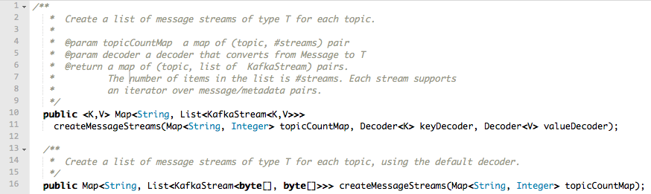
Serialization in Kafka
Kafka does not care about data format of msg payload
Up to developer (= you) to handle serialization/deserialization
Common choices in practice: Avro, JSON
(Code above is from the High Level Consumer API)

Slide 105
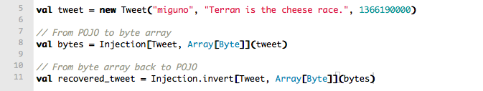
Serialization in Kafka: using Avro
One way to use Avro in Kafka is via Twitter Bijection.
https://github.com/twitter/bijection
Approach: Convert pojo to byte[], then send byte[] to Kafka.
Bijection in Scala:
Bijection in Java: https://github.com/twitter/bijection/wiki/Using-bijection-from-java
Full Kafka/Bijection example:
KafkaSpec in kafka-storm-starter
Alternatives to Bijection:
e.g. https://github.com/miguno/kafka-avro-codec

Slide 106
Data compression in Kafka

Slide 107
Data compression in Kafka
Again, no time to cover compression in this training.
But worth looking into!
Interplay with batching of messages, e.g. larger batches typically achieve better compression ratios.
Details about compression in Kafka:
https://cwiki.apache.org/confluence/display/KAFKA/Compression
Blog post by Neha Narkhede, Kafka committer @ LinkedIn: http://geekmantra.wordpress.com/2013/03/28/compression-in-kafka-gzip-or-snappy/

Slide 108
Example Kafka applications

Slide 109
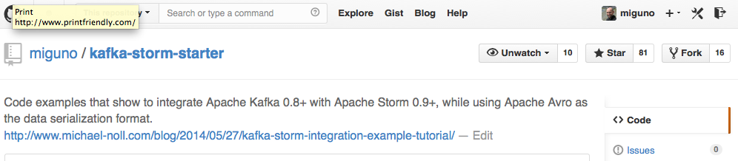
kafka-storm-starter
Written by yours truly
https://github.com/miguno/kafka-storm-starter
$ git clone https://github.com/miguno/kafka-storm-starter
$ cd kafka-storm-starter
# Now ready for mayhem!
(Must have JDK 6 installed.)

Slide 110
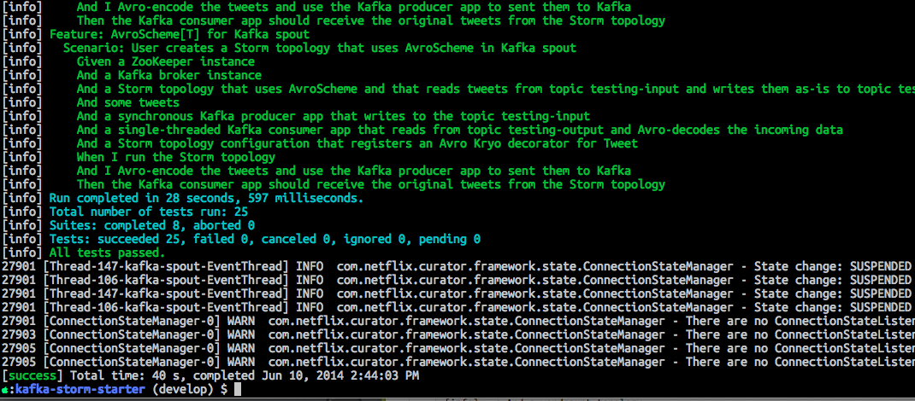
kafka-storm-starter: run the test suite
$ ./sbt test
Will run unit tests plus end-to-end tests of Kafka, Storm, and Kafka-Storm integration.

Slide 111
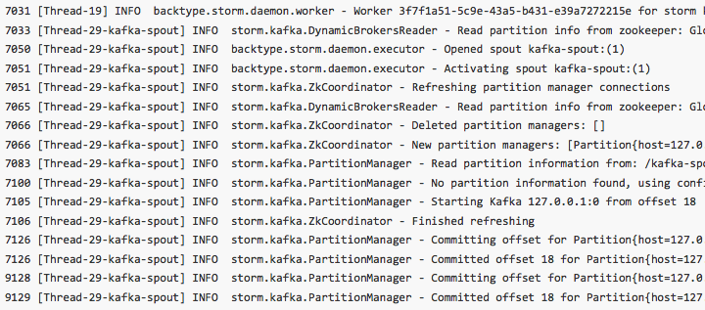
kafka-storm-starter: run the KafkaStormDemo app
$ ./sbt run
Starts in-memory instances of ZooKeeper, Kafka, and Storm. Then runs a Storm topology that reads from Kafka.

Slide 112
Kafka related code in kafka-storm-starter
KafkaProducerApp
https://github.com/miguno/kafka-storm-starter/blob/develop/src/main/scala/com/miguno/kafkastorm/kafka/KafkaProducerApp.scala
KafkaConsumerApp
https://github.com/miguno/kafka-storm-starter/blob/develop/src/main/scala/com/miguno/kafkastorm/kafka/KafkaConsumerApp.scala
KafkaSpec: test-drives producer and consumer above
https://github.com/miguno/kafka-storm-starter/blob/develop/src/test/scala/com/miguno/kafkastorm/integration/KafkaSpec.scala

Slide 113
Dev-related references
Kafka documentation
Kafka FAQ
Kafka tutorials
http://www.michael-noll.com/blog/2013/03/13/running-a-multi-broker-apache-kafka-cluster-on-a-single-node/
Code examples
https://github.com/miguno/kafka-storm-starter/

Slide 114
Part 5: Playing with Kafka using Wirbelsturm
1-click Kafka deployments

Slide 115
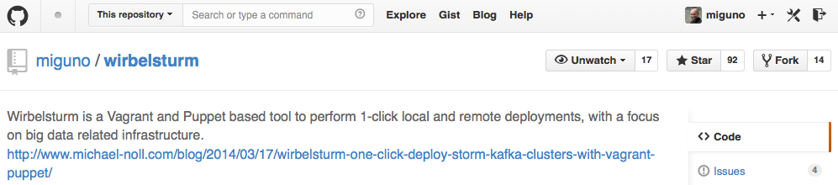
Deploying Kafka via Wirbelsturm
Written by yours truly
https://github.com/miguno/wirbelsturm
$ git clone https://github.com/miguno/wirbelsturm.git
$ cd wirbelsturm
$ ./bootstrap
$ vi wirbelsturm.yaml # uncomment Kafka section
$ vagrant up zookeeper1 kafka1
(Must have Vagrant 1.6.1+ and VirtualBox 4.3+ installed.)

Slide 116
What can I do with Wirbelsturm?
Get a first impression of Kafka
Test-drive your producer apps and consumer apps
Test failure handling
Stop/kill brokers, check what happens to producers or consumers.
Stop/kill ZooKeeper instances, check what happens to brokers.
Use as sandbox environment to test/validate deployments
“What will actually happen when I run this reassign partition tool?”
"What will actually happen when I delete a topic?"
“Will my Hiera changes actually work?”
Reproduce production issues, share results with Dev
Also helpful when reporting back to Kafka project and mailing lists.
Any further cool ideas? ☺

Slide 117
Wrapping up

Slide 118
Where to find help
No (good) Kafka book available yet.
Kafka documentation
http://kafka.apache.org/documentation.html
https://cwiki.apache.org/confluence/display/KAFKA/Index
Kafka ecosystem, e.g. Storm integration, Puppet
https://cwiki.apache.org/confluence/display/KAFKA/Ecosystem
Mailing lists
http://kafka.apache.org/contact.html
Code examples
examples/ directory in Kafka, https://github.com/apache/kafka/
https://github.com/miguno/kafka-storm-starter/

